Slide 1
Optical Heart rate and PPG monitor
Alex Tien 2014/07/21

Slide 2
Idea
Use Pulse Sensor Amped sensor module
Use OLED 128*64 display
Use Arduino Pro Mini
Shows heart rate and PPG waveform

Slide 3
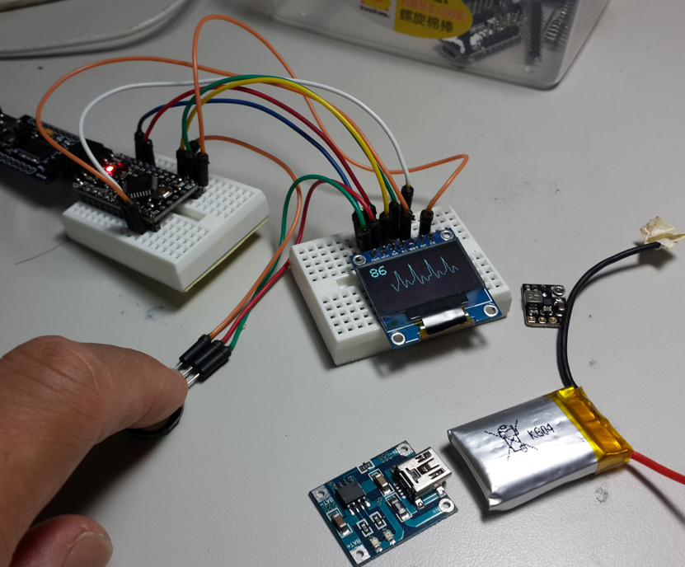
Prototyping

Slide 4
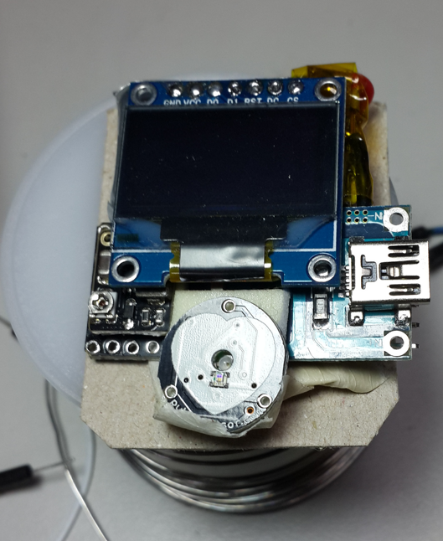
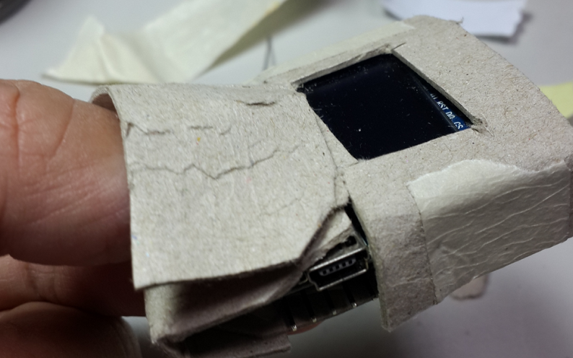
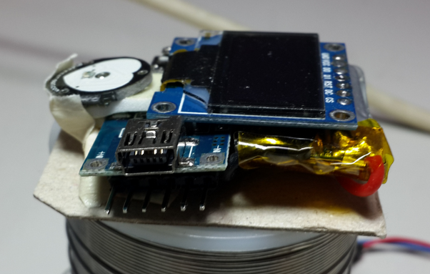
Stack up

Slide 5
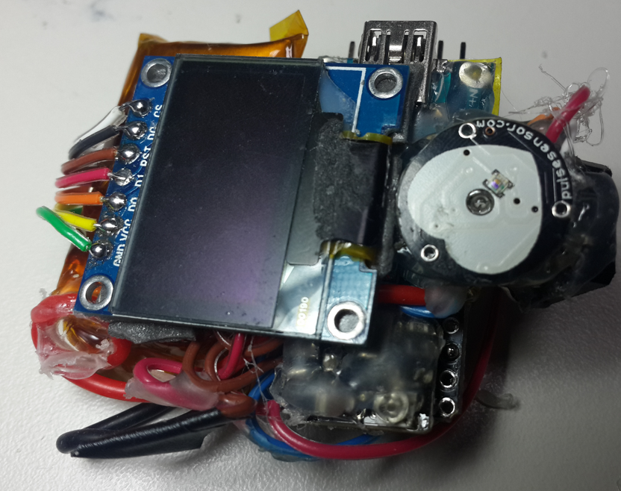
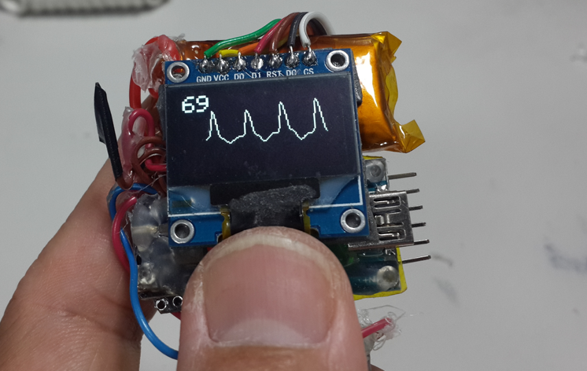
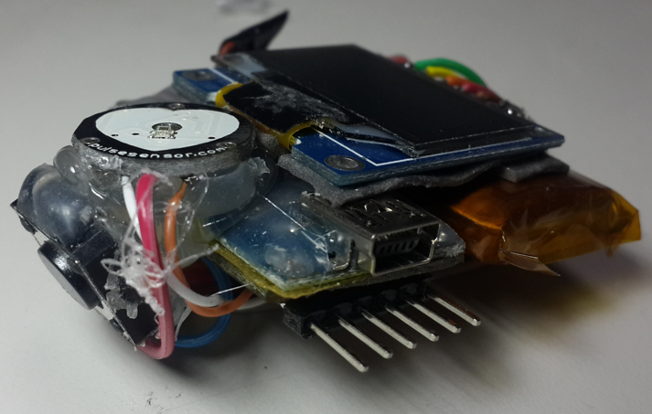
Wiring

Slide 6
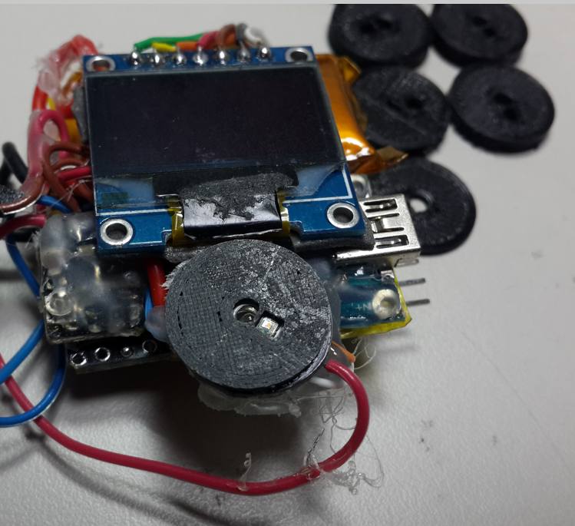
Optimizing
3 mm
2.5 mm
1.5 mm
2 mm
0.5 mm
Shielding, prevent
light leaking
1 mm thick

Slide 7
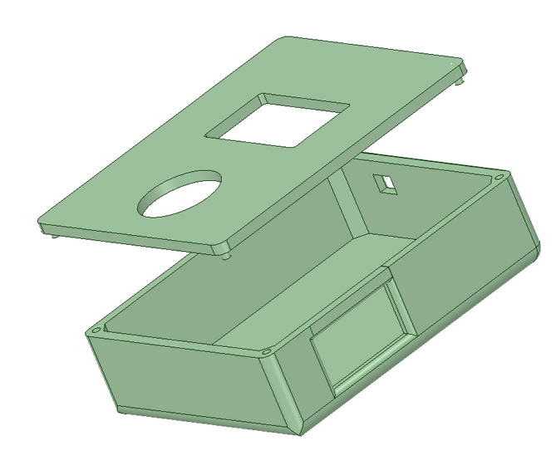
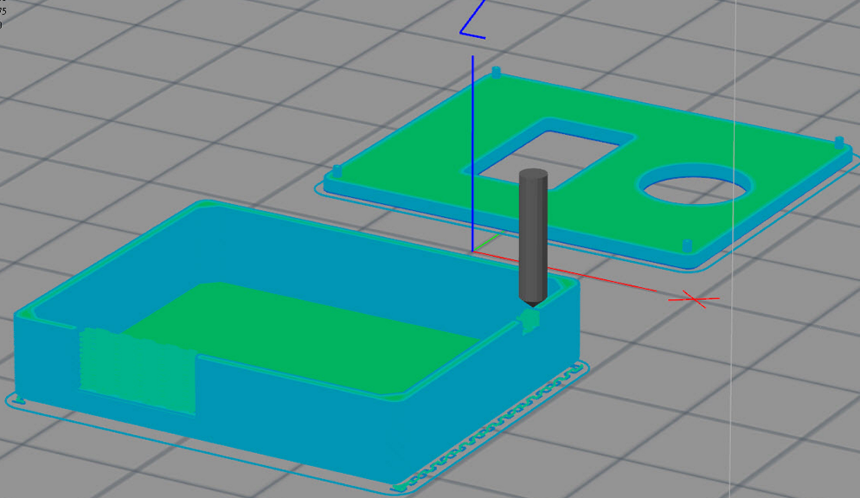
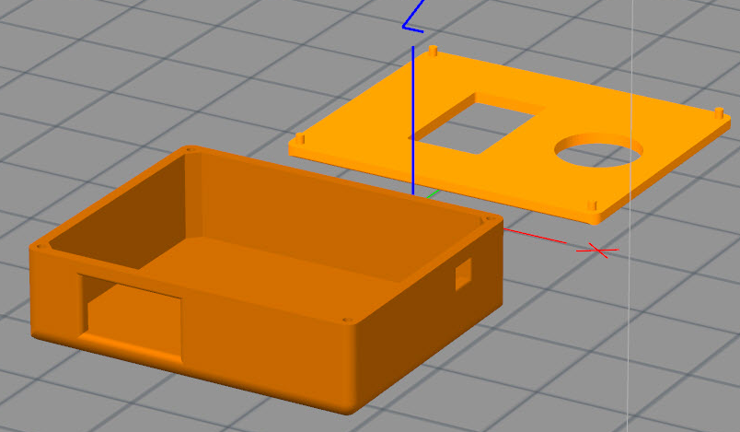
Creating case

Slide 8
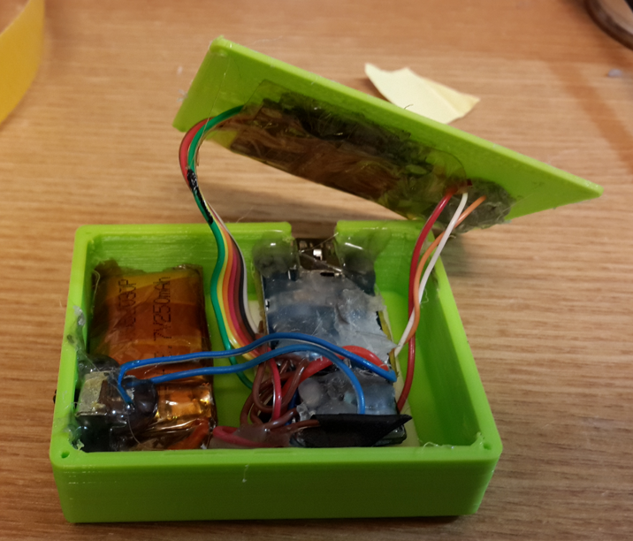
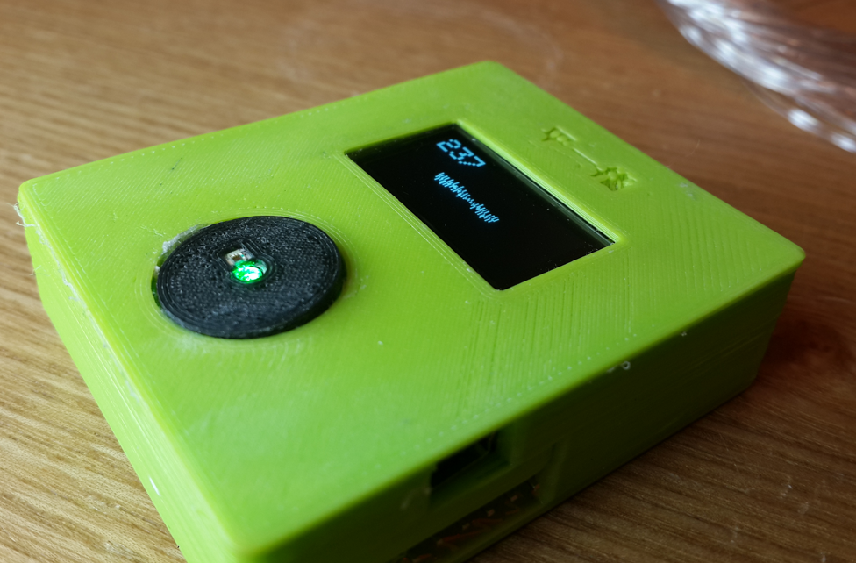
Assembling

Slide 9
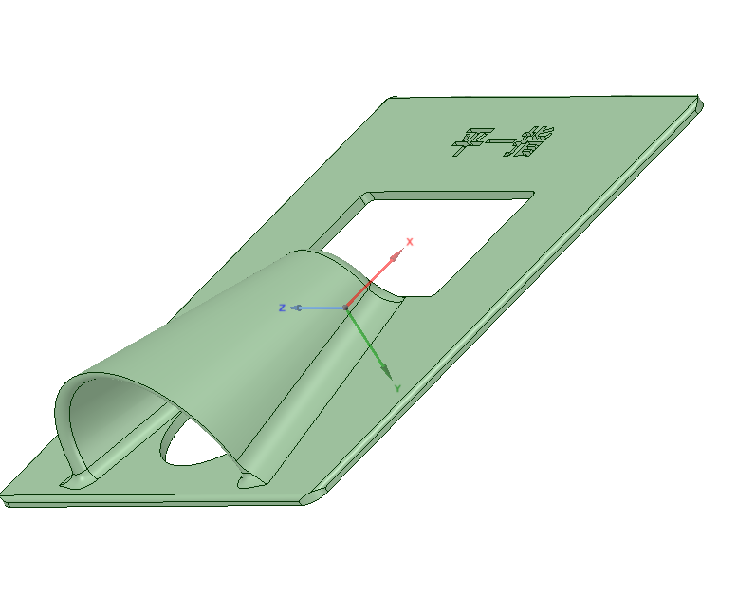
Upgrading

Slide 10
Video and information
Video:
http://youtu.be/qohW7fcGghU
3D printing file: https://www.dropbox.com/sh/hqlc2ezklnowxx3/AAC3ZW87aqNGZ3c4cPOouJhPa
Code:
https://www.dropbox.com/sh/40tg48yi248r5mp/AAB-D2zJeoplVewCDZ0kAtfya

